Slide 1


Yury Cavalcante
4th - January - 2024

Slide 2

Outline
Executive Summary
Introduction
Methodology
Results
Conclusion
Appendix

Slide 3
Executive Summary
Summary of methodologies
Summary of all results

Slide 4
Introduction
Project background and context
Cost Advantage: Falcon 9's launch cost is $62 million, significantly lower than competitors' average of $165 million.
Innovation in Reusability: Key savings due to Space X's ability to reuse the rocket's first stage.
Project Goal: Develop a machine learning model to predict the success of Falcon 9 first stage landings.
Competitive Analysis: Insightful for competitors aiming to bid against Space X.
Problems you want to find answers
Determinants of Success: What factors most influence the success of Falcon 9's first stage landing?
Feature Interactions: How do different operational parameters interact to affect landing outcomes?
Optimal Conditions: Identifying conditions that maximize successful landing probabilities.

Slide 5

Section 1

Slide 6
Methodology
Executive Summary
Data collection methodology:
Data sourced from SpaceX API and Wikipedia (via web scraping).
Perform data wrangling
Cleaning, structuring, and preparing data for analysis and applied one-hot encoding to transform categorical features for model compatibility.
Perform exploratory data analysis (EDA) using visualization and SQL
Perform interactive visual analytics using Folium and Plotly Dash
Perform predictive analysis using classification models
Construct classification models to predict launch outcomes based on historical data with techniques like grid search and cross-validation to fine-tune model parameters for optimal performance and Utilize metrics such as accuracy, precision, recall, and the ROC curve to thoroughly evaluate model effectiveness.

Slide 7

Data Collection
SpaceX API Usage:
Executed GET requests to retrieve launch data.
Data Decoding and Structuring:
Transformed API response to JSON format.
Used .json_normalize() to convert JSON to a pandas DataFrame.
Data Cleaning and Preprocessing:
Performed thorough data cleaning.
Identified and filled missing values.
Web Scraping for Additional Records:
Utilized BeautifulSoup for scraping Falcon 9 launch records from Wikipedia.
Extracted and parsed HTML tables to form structured DataFrame.

Slide 8
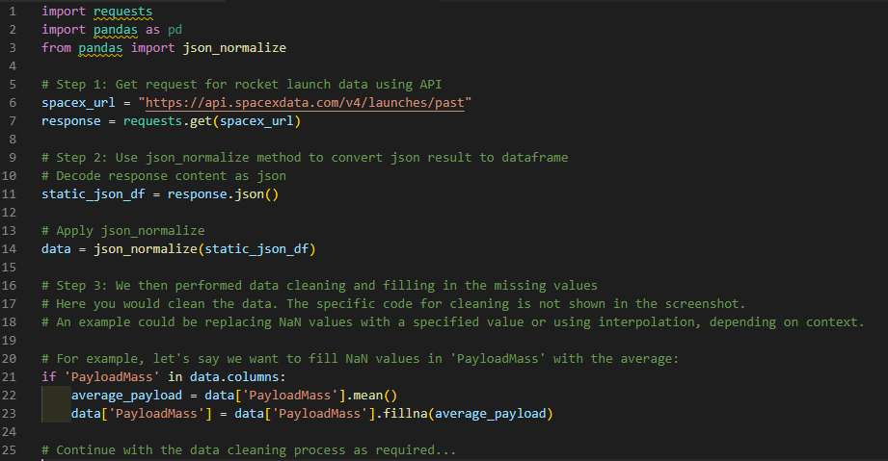
Data Collection – SpaceX API
We utilized the GET request method to retrieve data from the SpaceX API, followed by data cleansing and fundamental data wrangling and formatting tasks.
You can access the notebook detailing this process at this GitHub link: https://github.com/YUCAVALCANTE/Applied-Data-Science-Capstone---ibm/blob/main/001%20-%20Data%20Collection%20API.ipynb

Slide 9
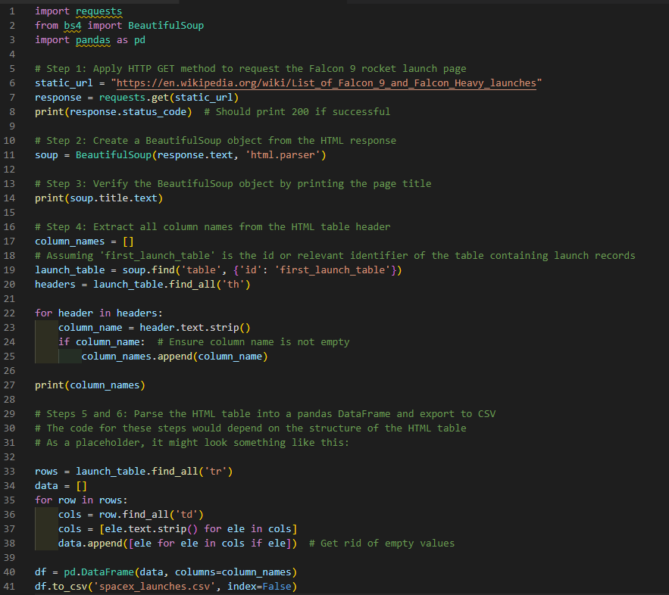
Data Collection - Scraping
We utilized web scraping to extract Falcon 9 launch records using BeautifulSoup.
The data was then parsed into a structured table and transformed into a pandas DataFrame for analysis.
You can find the notebook detailing this process at the following GitHub link: https://github.com/YUCAVALCANTE/Applied-Data-Science-Capstone---ibm/blob/main/002%20-%20Data%20Collection%20with%20Web%20Scraping.ipynb

Slide 10
Data Wrangling
Our data wrangling process involved several key steps to prepare the dataset for exploratory data analysis and model training:
Data Acquisition: We initiated the process by collecting data through API calls and web scraping methods, employing libraries like requests for API interactions and BeautifulSoup for parsing HTML content.
Data Transformation: We used json_normalize to convert JSON responses into a structured pandas DataFrame. This facilitated the subsequent handling and manipulation of the data.
Exploratory Data Analysis (EDA): We conducted an exploratory analysis to understand the dataset's characteristics, including the distribution and relationship of various features.
Feature Engineering: We derived new informative features from existing data, such as calculating the total number of launches per site and categorizing orbits.
Label Determination: The 'Outcome' column was processed to create a binary 'Landing Outcome' label, which served as our target variable for subsequent predictive modeling tasks.
Data Cleaning: We addressed missing values, outliers, and anomalies to improve data quality, ensuring that the dataset was suitable for training machine learning models.
Exporting Data: After preprocessing and cleaning, we exported the processed data to a CSV file for easy access and reproducibility of results.
Documentation and Sharing: We documented the entire data wrangling process in Jupyter notebooks and shared them on GitHub for peer review and external reference.
For a visual representation of our data wrangling process, a flowchart was created and included in the project documentation.
You can find the Jupyter notebooks detailing each of these steps in our data wrangling process at the following GitHub link: https://github.com/YUCAVALCANTE/Applied-Data-Science-Capstone---ibm/blob/main/003%20-%20Data%20Wrangling.ipynb

Slide 11
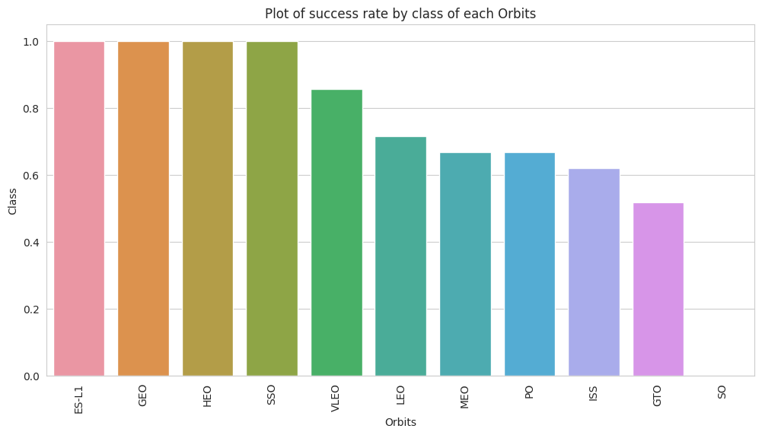

EDA with Data Visualization
SPACEX LAUNCH DATA: INSIGHTS & TRENDS
Flight Number vs. Launch Site: Scatter plots show the influence of experience on launch success.
Payload vs. Launch Site: Scatter plots analyze the impact of payload mass on the success rate at various sites.
Success Rate by Orbit Type: Bar charts reveal success rates and challenges associated with different orbits.
Flight Number vs. Orbit Type: Scatter plots examine the relationship between mission count and orbit types, hinting at technological advancements.
Yearly Trend of Launch Success: Line charts depict the progression and consistency of successful launches over time.
Visualization Choices: Each chart was carefully selected to clearly convey key data relationships and to inform strategic planning for future missions.
Detailed Analysis: Explore our full EDA and visualization work on GitHub: https://github.com/YUCAVALCANTE/Applied-Data-Science-Capstone---ibm/blob/main/005%20-%20EDA%20with%20Visualization%20Lab.ipynb

Slide 12
EDA with SQL
Unique Launch Sites: Retrieved distinct names of launch sites to understand the variety of launch locations.
Launch Sites with 'CCA': Selected records where launch site names begin with 'CCA' to filter specific geographic data.
Total Payload by NASA (CRS): Calculated the cumulative payload mass for missions contracted by NASA (CRS).
Average Payload for F9 v1.1: Computed the average payload mass carried by the Falcon 9 version 1.1 booster.
First Successful Ground Pad Landing: Identified the date of the first successful landing on a ground pad.
Successful Boosters for Drone Ship Landings: Listed booster names with successful drone ship landings and specific payload mass range.
Mission Outcomes: Counted the total number of successful and failed mission outcomes.
Heaviest Payload Missions: Found booster versions that carried the maximum payload mass.
Failure Details in 2015: Detailed failed landing outcomes, booster versions, and launch sites for missions in 2015.
Landing Outcomes Ranking: Ranked landing outcomes by frequency between specified dates.
For peer review and to access the complete set of SQL queries performed for the EDA, please refer to the Jupyter notebook available at the following GitHub link: https://github.com/YUCAVALCANTE/Applied-Data-Science-Capstone---ibm/blob/main/004%20-%20EDA%20with%20SQL.ipynb

Slide 13
Build an Interactive Map with Folium
Interactive Map Visualization with Folium
Launch Site Markers: Marked all launch sites on the map to provide geographical context.
Outcome Indicators: Added markers and circles to represent the success (Class 1) or failure (Class 0) of each launch, enhancing visual analytics.
Success Rate Visualization: Utilized color-coded clusters to distinguish between launch sites based on their success rates, allowing for quick assessment of performance.
Proximity Analysis: Calculated and displayed the distances from each launch site to nearby railways, highways, and coastlines to understand logistical advantages.
City Distances: Evaluated the remoteness of launch sites from populated areas for safety and security considerations.
Map Objects Rationale: Each object was integrated to facilitate a comprehensive understanding of launch site selection, operational success, and strategic positioning in relation to essential infrastructure and urban areas.
Further Exploration: For an in-depth review of the interactive mapping analysis, visit the GitHub repository: https://github.com/YUCAVALCANTE/Applied-Data-Science-Capstone---ibm/blob/main/006%20-%20Interactive%20Visual%20Analytics%20with%20Folium%20lab.ipynb

Slide 14
Build a Dashboard with Plotly Dash
Launch Site Distribution: Incorporated pie charts to depict the distribution of total launches from various sites, enabling a clear visual comparison of launch site activity.
Booster Performance Analysis: Integrated scatter plots to illustrate the relationship between launch outcomes and payload mass for different booster versions. This interaction helps to discern patterns and trends in booster performance relative to the mass they carry.
User Interactivity: Added dropdowns, sliders, and other interactive components to allow users to filter and customize the data views. These interactions enhance user engagement and enable personalized data exploration.
Rationale for Dashboard Elements: The chosen visualizations and interactive features are designed to provide intuitive insights into launch frequencies and efficiencies, as well as to facilitate a deeper understanding of the factors contributing to mission success.

Slide 15
Predictive Analysis (Classification)
MODEL DEVELOPMENT PROCESS
Data Preparation: We began by loading the dataset into a NumPy array and a pandas DataFrame, followed by data transformation and normalization to prepare for machine learning.
Training and Testing: We split the dataset into training and testing sets to ensure a robust evaluation of model performance.
Model Building: Various machine learning models were constructed, including logistic regression, SVM, decision trees, and KNN, to identify baseline accuracies.
Hyperparameter Tuning: Utilized GridSearchCV to systematically work through multiple combinations of parameter tunes, cross-validating as we went to determine the most effective settings.
Performance Evaluation: We employed accuracy as the primary metric to assess each model, using the testing set to gauge generalization capabilities.
Feature Engineering and Tuning: Enhanced model performance by engineering new features from existing data and refining algorithms.
Best Model Selection: Through iterative tuning and evaluation, we identified the classification model that yielded the highest accuracy, signifying the best predictive performance.
Key Phrases: Data Loading, Model Training, Hyperparameter Optimization, Accuracy Measurement, Feature Engineering, Best Model Identification.
Flowchart: A flowchart would be created to visually represent the step-by-step process from data loading to final model selection.
Comprehensive Analysis and Code: Explore our model development journey in detail on GitHub: https://github.com/YUCAVALCANTE/Applied-Data-Science-Capstone---ibm/blob/main/007%20-%20Machine%20Learning%20Prediction%20lab.ipynb

Slide 16
Results
Exploratory data analysis results
Interactive analytics demo in screenshots
Predictive analysis results

Slide 17

Section 2

Slide 18
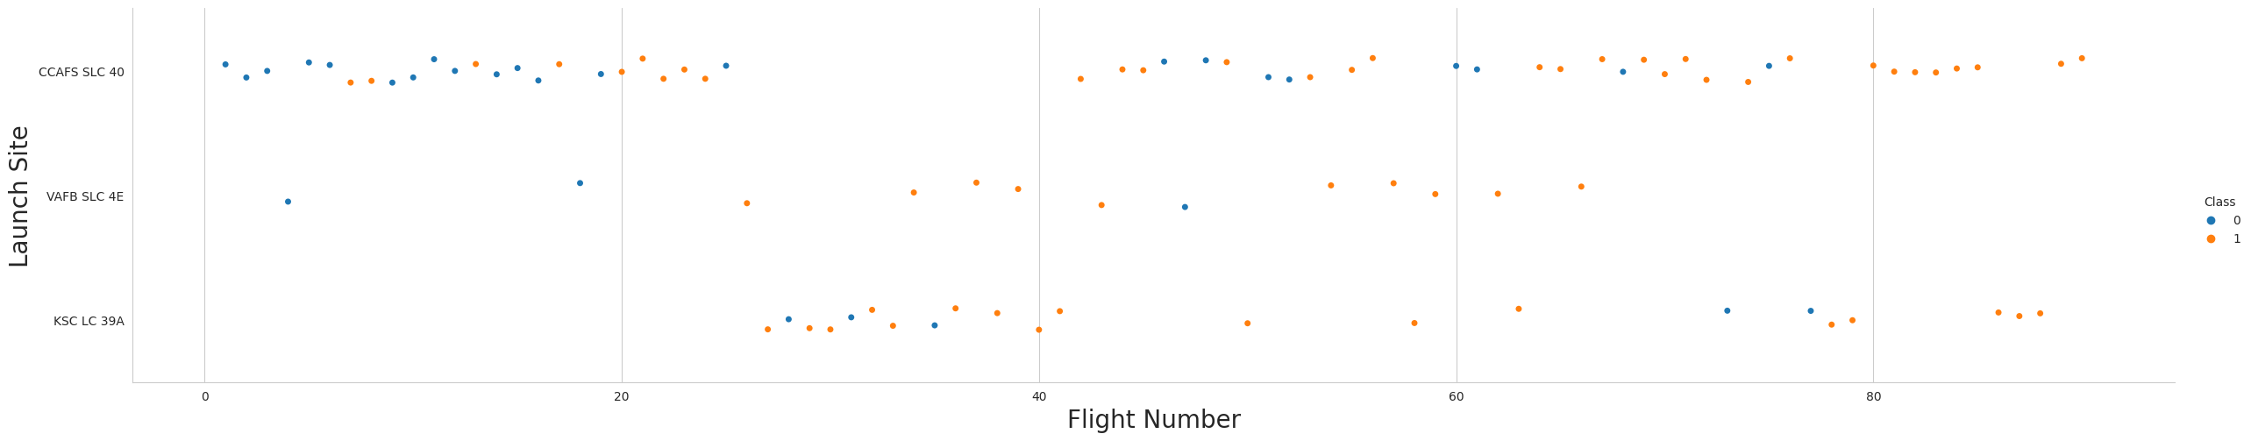
Flight Number vs. Launch Site
Visualization: Scatter plot with Flight Number (X-axis) and Launch Site (Y-axis).
Color Coding:
Blue dots represent failed launches (Class 0).
Orange dots indicate successful launches (Class 1).
Insights:
Increased flight numbers correlate with a higher success rate.
Suggests operational learning enhances success over time.
Launch Site Performance:
Allows comparison of launch success across different sites.
Can identify sites with higher efficiency and reliability.

Slide 19
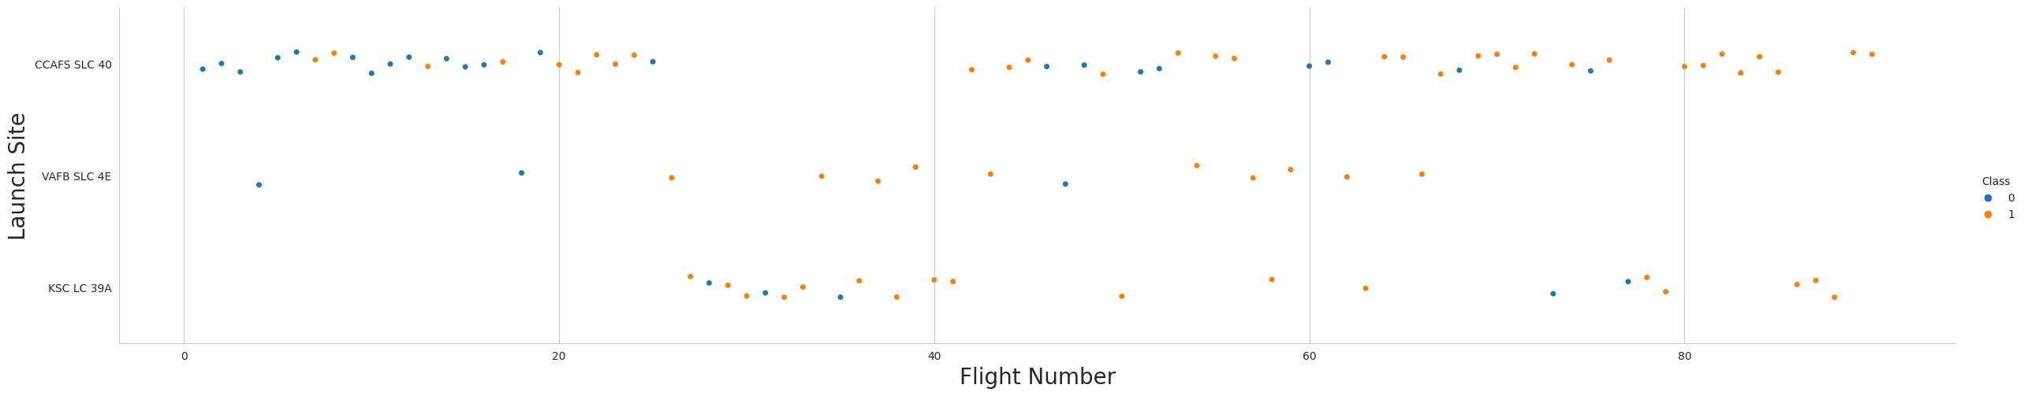
Payload vs. Launch Site
Visualization: Scatter plot with Payload Mass (X-axis) against Launch Site (Y-axis).
Color Coding:
Blue dots indicate failed launches (Class 0).
Orange dots indicate successful launches (Class 1).
Insights:
Larger payload masses at CCAFS SLC 40 are associated with a higher success rate.
Demonstrates the site's capability to handle significant payloads effectively.
Impact:
Highlights the importance of payload capacity in mission planning and success.
Suggests infrastructure and experience at CCAFS SLC 40 are conducive to successful launches.

Slide 20
Success Rate vs. Orbit Type
Visualization: Bar chart comparing the success rates across different orbits.
High Success Rates:
ES-L1, GEO, HEO, SSO, VLEO orbits display the highest success rates.
Orbit Insights:
These orbits are indicative of reliable mission profiles within SpaceX's operations.
Strategic Implications:
Understanding orbit-specific success rates can inform future mission planning and risk assessment.

Slide 21
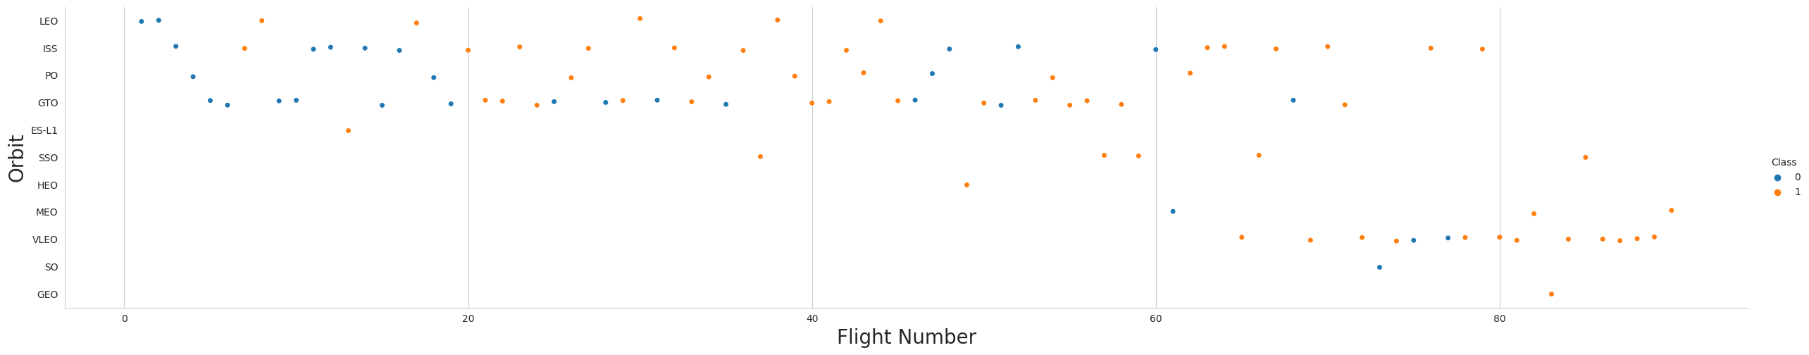
Flight Number vs. Orbit Type
Visualization: Scatter plot displaying the relationship between Flight Number and Orbit Type.
Orbit Insights:
In Low Earth Orbit (LEO), a higher flight number correlates with increased success.
In Geostationary Transfer Orbit (GTO), success seems independent of flight number.
Implications:
Suggests accumulated experience enhances success rates in certain orbits like LEO.
Indicates that factors other than experience may influence success in GTO orbits.
Operational Strategy:
Insights can guide targeted improvements and resource allocation for specific orbit types.

Slide 22
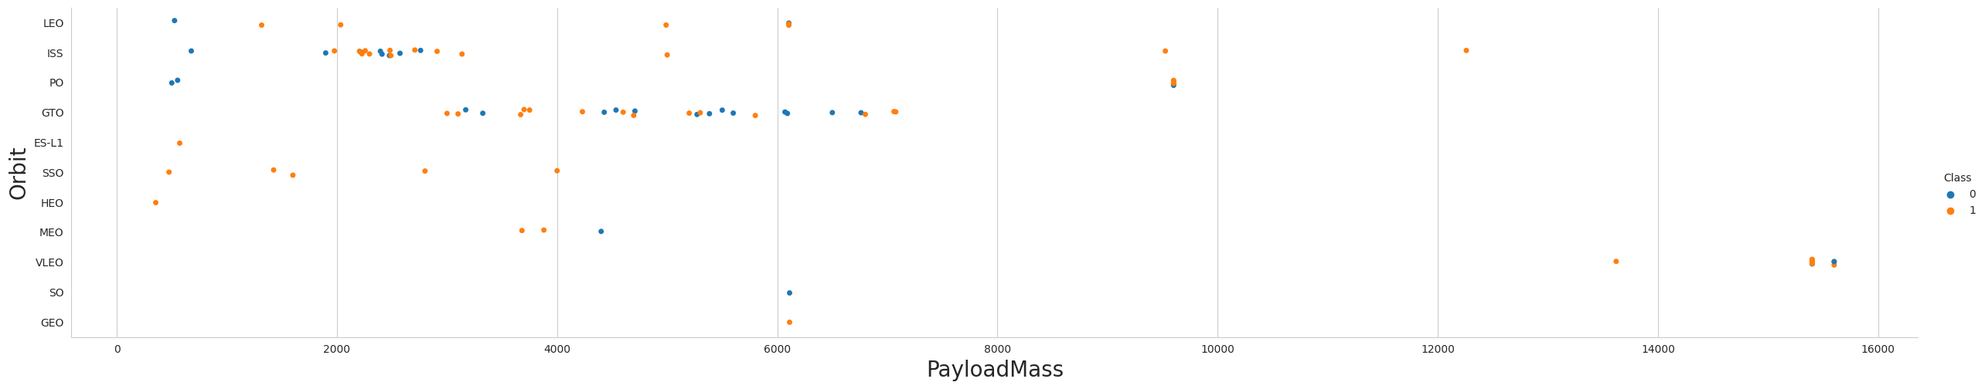
Payload vs. Orbit Type
Visualization: Scatter plot with Payload Mass (X-axis) versus Orbit Type (Y-axis).
Observations:
Heavier payloads are more likely to result in successful landings, particularly in Polar Orbit (PO), Low Earth Orbit (LEO), and International Space Station (ISS) missions.
Implications:
Indicates the capability of SpaceX's rockets to deliver heavy payloads to specific orbits with high success.
May influence mission planning regarding payload allocations for different orbit types.

Slide 23
Launch Success Yearly Trend
Visualization: Line chart with Year (X-axis) and Average Success Rate (Y-axis).
Trend Observation:
Steady increase in success rate from 2013 through 2020.
Performance Highlight:
Demonstrates significant improvement in launch reliability over time.
Strategic Insights:
The trend underscores the effectiveness of SpaceX's iterative learning and advancements in technology.

Slide 24
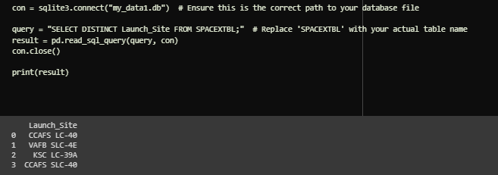
All Launch Site Names
IDENTIFYING UNIQUE SPACEX LAUNCH SITES
SQL Query: Utilized SELECT DISTINCT to extract unique launch site names.
Purpose: To identify all different launch locations used by SpaceX.
Database Connection: Connected to SQLite database my_data.db.
Query Execution: Retrieved distinct names from SPACEXTBL.
Insight: The distinct keyword effectively filters out duplicate entries, ensuring each launch site is listed only once.

Slide 25
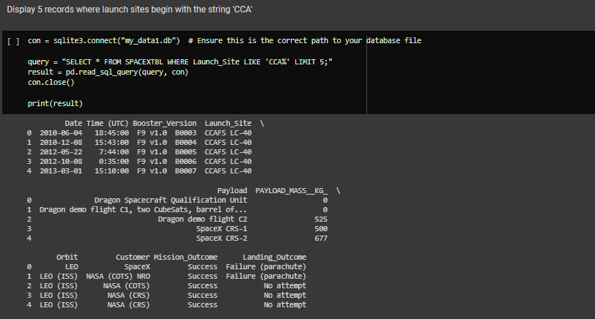
Launch Site Names Begin with 'CCA'
SQL Query: Implemented a query with a LIKE clause to find records starting with 'CCA'.
Data Retrieval: Fetched 5 records from the database where launch site names start with 'CCA'.
Purpose: To isolate and analyze launches from CCAFS sites.
Query Result:
Displayed a snippet of launch records including Date, Payload, and Outcome.
Confirms all selected records are from the CCAFS LC-40 launch site.

Slide 26
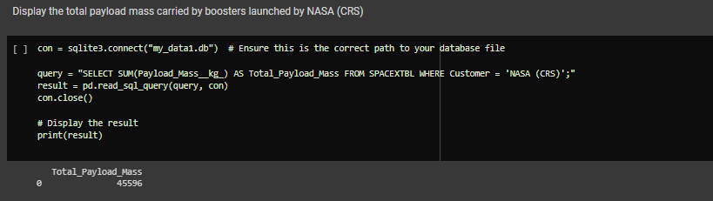
Total Payload Mass
Objective: Calculate the cumulative payload mass for NASA's Commercial Resupply Services.
SQL Query: Executed an aggregate SUM function on the Payload_Mass_kg column.
Criteria: Focused on missions where the customer is 'NASA (CRS)'.
Result: The total payload mass delivered by SpaceX for NASA (CRS) is 45,596 kg.
Significance: Highlights the substantial contribution of SpaceX to NASA's resupply missions.

Slide 27
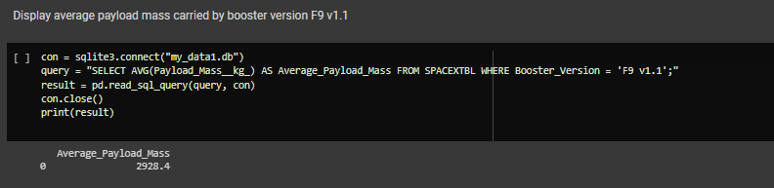
Average Payload Mass by F9 v1.1
Objective: Determine the average payload mass delivered by the F9 v1.1 booster.
SQL Query: Used the AVG function to calculate the mean payload mass.
Filter Applied: Specific to missions with booster version 'F9 v1.1'.
Result: The F9 v1.1 booster's average payload mass is 2,928.4 kg.
Significance: Reflects the payload capacity and performance of the F9 v1.1 model.

Slide 28
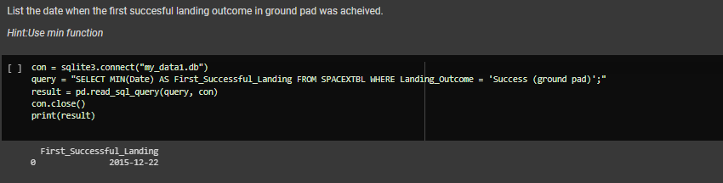
First Successful Ground Landing Date
FIRST SUCCESSFUL GROUND PAD LANDING
Goal: Identify the date of the inaugural successful landing on a ground pad.
SQL Query: Employed the MIN function to find the earliest date of success.
Criteria: Filtered for landings with the outcome 'Success (ground pad)'.
Discovery: The first successful ground pad landing occurred on December 22, 2015.
Historical Milestone: Marks a significant achievement in SpaceX's reusable launch system development.

Slide 29
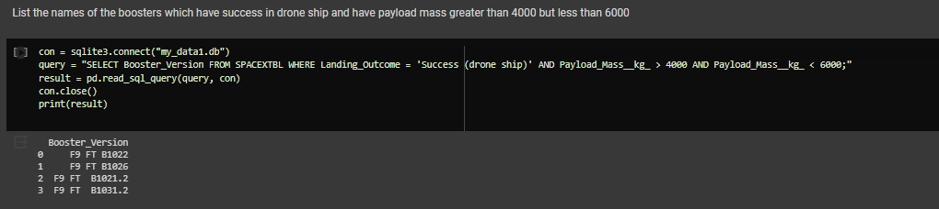
Successful Drone Ship Landing with Payload between 4000 and 6000
BOOSTERS WITH SUCCESSFUL DRONE SHIP LANDINGS AND SPECIFIC PAYLOAD MASS
Criteria: Selected boosters that landed on a drone ship with payloads between 4000 and 6000 kg.
SQL Query:
Applied a WHERE clause to filter for successful drone ship landings.
Used AND to specify the payload mass range criteria.
Query Result: Identified boosters including F9 FT B1022, F9 FT B1026, and F9 FT B1021.2.
Implications: Indicates the capability of these boosters to deliver significant payloads while achieving landing success.

Slide 30
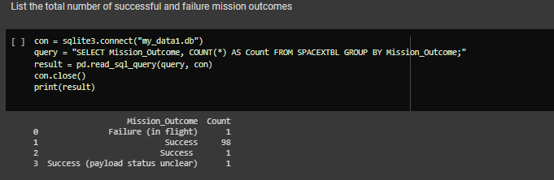
Total Number of Successful and Failure Mission Outcomes
MISSION OUTCOMES: SUCCESS VS. FAILURE
Objective: Calculate the count of mission outcomes, distinguishing between successes and failures.
SQL Query:
Used GROUP BY to aggregate results based on Mission_Outcome.
Employed the COUNT function to tally the number of occurrences.
Methodology: No wildcard % was actually used in the provided query; the query simply groups and counts the different outcomes.

Slide 31
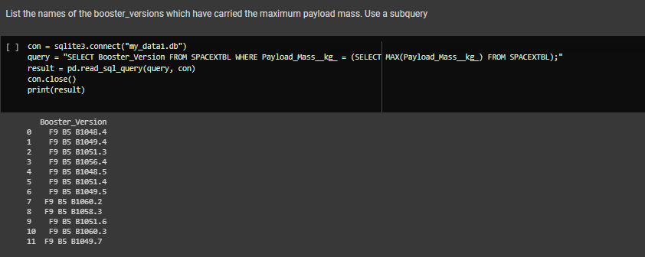
Boosters Carried Maximum Payload
Objective: Identify booster versions that have transported the heaviest payloads.
SQL Query Strategy:
Implemented a subquery to determine the maximum payload mass.
Selected booster versions equal to this maximum mass.
Query Result: Listed multiple iterations of Falcon 9 boosters, such as B1048.4 and B1051.3.
Analysis: Indicates these specific boosters are capable of carrying the most substantial payloads.

Slide 32
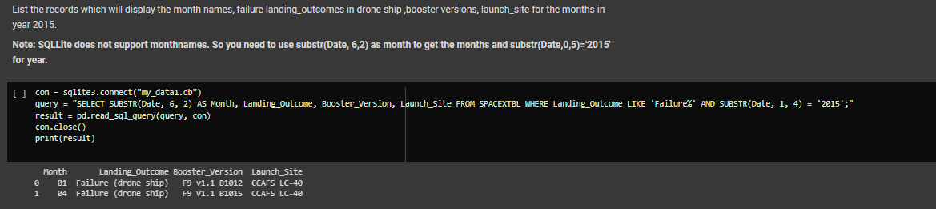
2015 Launch Records
2015 FAILED DRONE SHIP LANDING OUTCOMES
Query Focus: Isolate drone ship landing failures with corresponding booster versions and launch sites from 2015.
SQL Techniques:
Utilized WHERE clause with LIKE to specify 'Failure' outcomes.
Applied SUBSTR function to filter records by the year '2015'.
Query Result: Identified two failures: one in January (01) and one in April (04), both at CCAFS LC-40.
Methodology: The query was carefully crafted to extract precise information within a specific time frame and conditions.

Slide 33
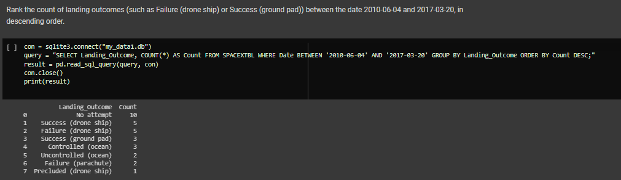
Rank Landing Outcomes Between 2010-06-04 and 2017-03-20
Query Objective: Quantify and rank the frequency of different landing outcomes within the specified period.
SQL Strategy:
Filtered outcomes using WHERE clause for dates between 2010-06-04 and 2017-03-20.
Grouped the data by Landing_Outcome using GROUP BY.
Ordered the counts in descending order with ORDER BY.
Query Result:
Most common outcome was 'No attempt' followed by successful drone ship and ground pad landings.
Less frequent were various forms of unsuccessful landings including controlled ocean landings and drone ship failures.
Insight: Provides a clear understanding of landing success rates and the evolution of landing techniques over time.

Slide 34

Section 3

Slide 35
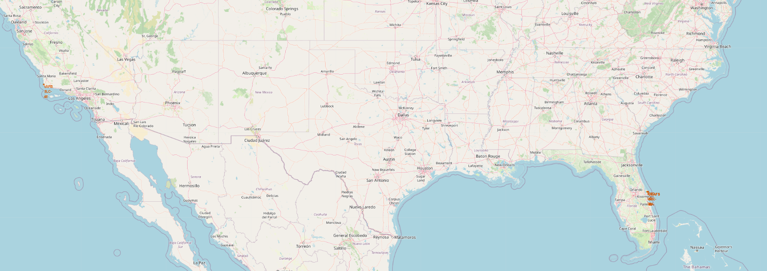
Global Distribution of SpaceX Launch Sites
Location Markers:
CCAFS SLC 40 at Cape Canaveral, Florida.
VAFB SLC 4E at Vandenberg Air Force Base, California.
Key Observations:
Launch sites are strategically located on coastlines, facilitating trajectory planning and reducing risk to populated areas.
Proximity to the equator at Florida's site maximizes payload efficiency by leveraging the Earth's rotation.

Slide 36
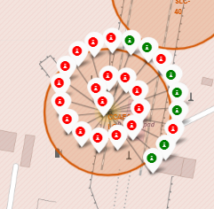
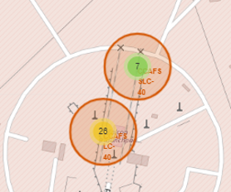
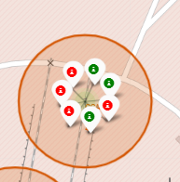
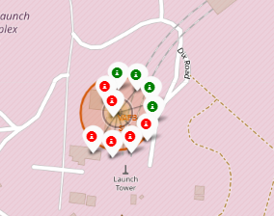
Launch Outcomes at SpaceX Sites
Visualization: Folium maps with color-coded markers for each launch outcome.
Green Markers: Represent successful launches. / Red Markers: Indicate failed launches.
Insights:
The proximity of green markers to launch pads reflects SpaceX's increasing landing success rate over time.
Red markers highlight the challenges and learning opportunities from early failures.
Strategic Implications:
Marker colors on the map provide immediate visual feedback on the historical performance of each site.
Analysis of marker distribution can inform future improvements in launch and landing operations.
FLORIDA LAUNCH SITES
Dense clustering of markers around CCAFS SLC 40.
A mix of successful and failed launches, with successes predominating in recent years.
CALIFORNIA LAUNCH SITE
VAFB SLC 4E shows fewer launches but a high success rate.

Slide 37
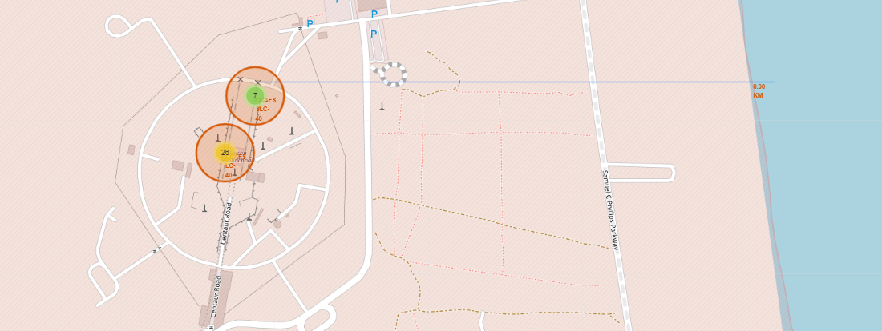
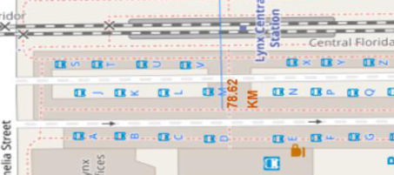
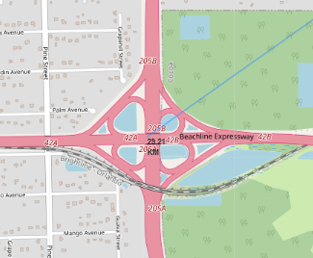
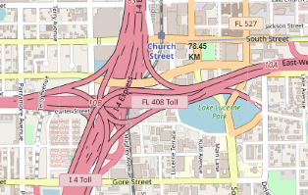
Proximity Analysis for Launch Sites
Focus: Assessing the strategic placement of launch sites concerning railways, highways, coastlines, and cities.
Visual Aid: Folium map displaying calculated distances to various landmarks.
Key Distances:
To City (1): Launch sites maintain a significant distance from populated areas for safety. Example: 78.45 km from the nearest city.
To Highway (2): Accessibility via highways is ensured, with the closest being 29.21 km away.
To Railway (3): Sites are typically not in close proximity to railways, supporting operational security. Example: 78 km from the nearest railway station.
To Coastline (4): Proximity to the coastline is crucial for trajectory planning and potential splashdowns. Example: 0.90 km from the coast.
Safety & Logistics:
The locations suggest a balance between safety requirements and logistical needs for transport and recovery operations.
Strategic Placement:
Sites are strategically chosen to optimize launch conditions and ensure public safety, while maintaining accessibility for logistical support.
4
3
2
1

Slide 38

Section 4

Slide 39
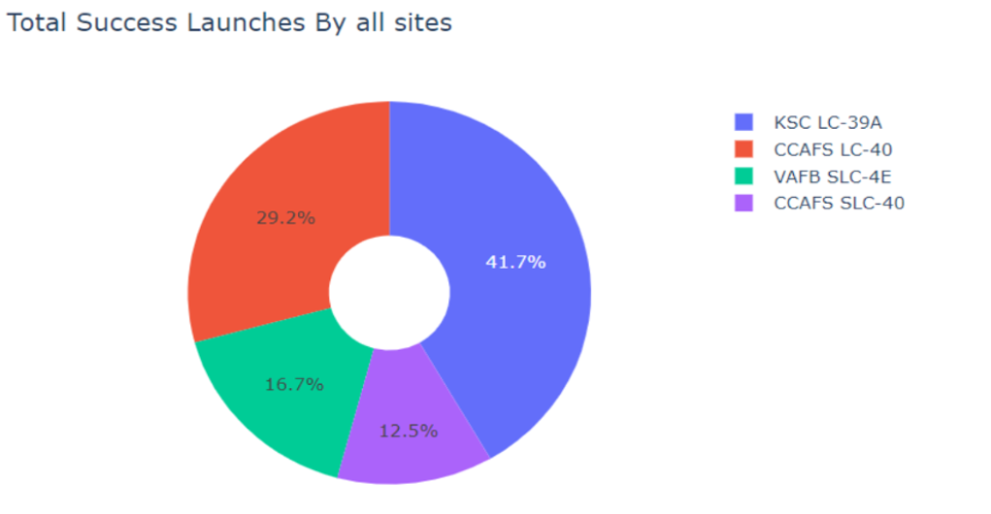
Launch Success Distribution Across SpaceX Sites
Visualization: Pie chart illustrating the proportion of successful launches from each SpaceX site.
Key Data Points:
KSC LC-39A has the highest share of successful launches, representing 41.7% of the total.
CCAFS LC-40 is also a significant contributor to success, split between two entries in the chart due to data representation.
VAFB SLC-4E contributes 16.7%, showcasing its role in SpaceX's operations.
Insights:
The data underscores KSC LC-39A's prominent role in SpaceX's successful missions.
The pie chart's color coding makes it easy to distinguish between the sites.
Analysis:
The success distribution reflects both the operational history and the evolution of launch site usage over time.

Slide 40
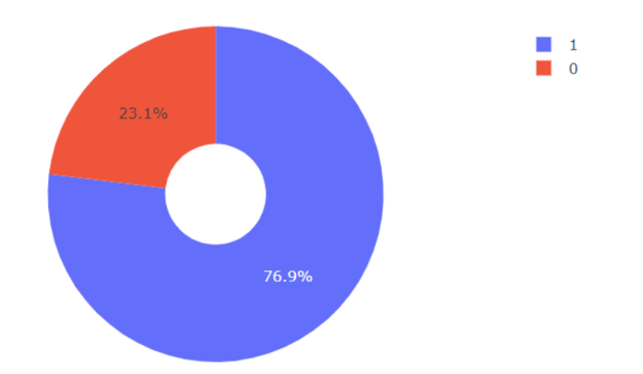
Launch Success Ratio for KSC LC-39A
Visualization: Pie chart displaying the success-to-failure ratio of launches.
Color Coding:
Blue represents successful launches (76.9%).
Red indicates failed launches (23.1%).
Key Takeaway:
KSC LC-39A has a high success rate, demonstrating its reliability as a launch site.
Implications:
The substantial success rate underscores the effectiveness of launch operations and technology at KSC LC-39A.
Analysis:
The pie chart provides a clear visual representation of launch outcomes, facilitating quick assessment of site performance.

Slide 41
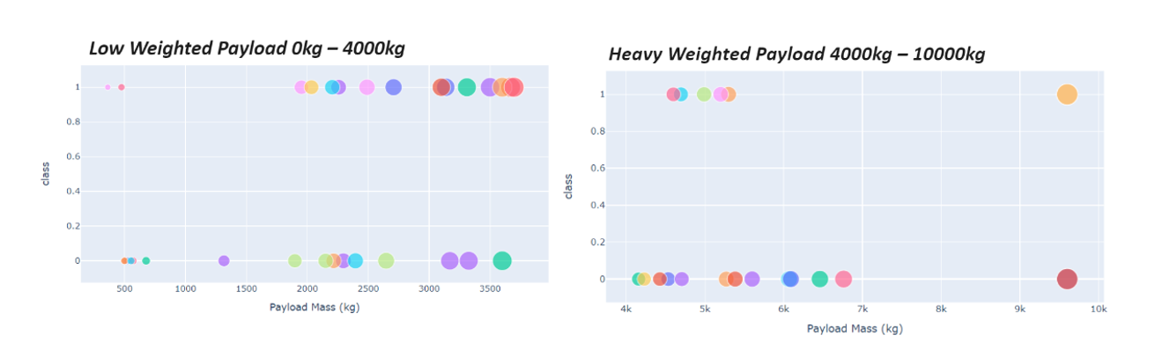
Scatter Plot of Payload vs. Launch Outcome for All Sites
Using a range slider, we explored the relationship between payload weight and launch outcomes.
Notably, the success rates for low-weighted payloads are higher compared to heavy payloads.
Further analysis can help identify specific payload ranges or booster versions associated with the largest success rates.

Slide 42

Section 5

Slide 43
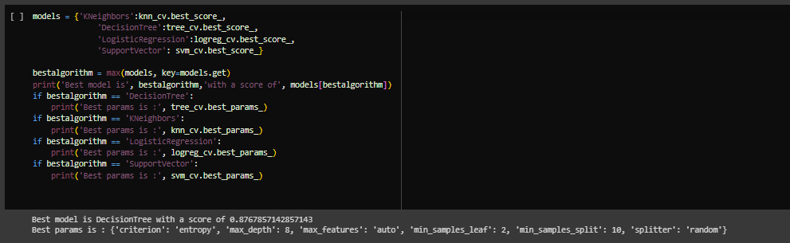
Classification Accuracy
The decision tree classifier achieves the highest level of classification accuracy among the models.

Slide 44
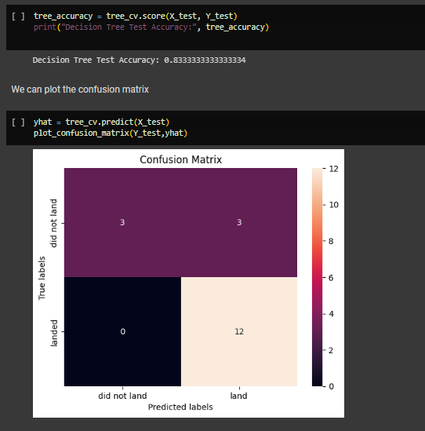
Confusion Matrix
The confusion matrix of the decision tree classifier reveals its ability to differentiate between various classes, with a noteworthy concern being the occurrence of false positives. These false positives indicate instances where the classifier incorrectly identifies unsuccessful landings as successful ones.

Slide 45
Conclusions
Launch Site Performance: The analysis of launch success rates across different sites revealed that certain launch sites, such as KSC LC-39A, consistently achieve high success rates, highlighting their reliability and effectiveness.
Payload Mass Impact: The investigation into the relationship between payload mass and launch success demonstrated that for specific orbit types, heavier payloads tend to result in more successful missions, suggesting the importance of payload considerations in mission planning.
Orbit Type Significance: The success rates associated with different orbit types indicated variations in mission complexity. This insight can inform mission planning and resource allocation for specific orbits.
Positive Launch Trend: Over the years, there has been a positive trend in launch success rates, showcasing advancements in space technology and mission execution. This trend bodes well for future space exploration endeavors.
Booster Version Impact: The analysis of different booster versions revealed variations in their performance. Some booster versions exhibited higher success rates, while others faced challenges. Understanding the strengths and weaknesses of each version is crucial for future mission planning.
Geographical Insights: The exploration of launch site locations and their proximity to transportation infrastructure and coastlines provided valuable insights into site selection strategies. These findings can guide decisions on future launch site locations for optimal mission success.
Yearly Improvement: Over the years, there has been a noticeable improvement in the success rate of SpaceX missions. This upward trend suggests that SpaceX's commitment to innovation and continuous improvement has resulted in more reliable and successful launches.

Slide 46
Appendix
Python Code Snippets
Data Preprocessing Code: Link to Code
Machine Learning Model Development Code: Link to Code
SQL Queries
SQL Queries for Data Analysis: Link to Queries
Exploratory Data Analysis Charts
Scatter Plot: Flight Number vs. Launch Site: Link to Chart
Scatter Plot: Payload vs. Launch Site: Link to Chart
Bar Chart: Success Rate by Orbit Type: Link to Chart
Scatter Plot: Flight Number vs. Orbit Type: Link to Chart
Scatter Plot: Payload vs. Orbit Type: Link to Chart
Line Chart: Yearly Average Success Rate: Link to Chart
Interactive Analytics Dashboard
Pie Chart: Launch Success Count for All Sites: Link to Chart
Pie Chart: Launch Site with Highest Success Ratio: Link to Chart
Predictive Analysis Results
Model Evaluation Metrics: Link to Results

Slide 47


